Slide 1
RC Ribbed Slabs

Slide 2
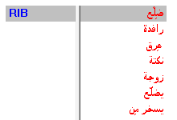
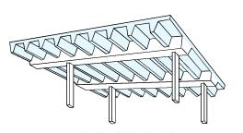
Meaning of word RIB

Slide 3
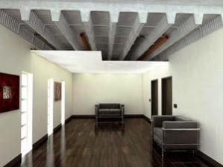
One-way ribbed slab

Slide 4
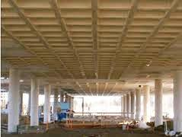
Two-way ribbed slab Waffle slab

Slide 5
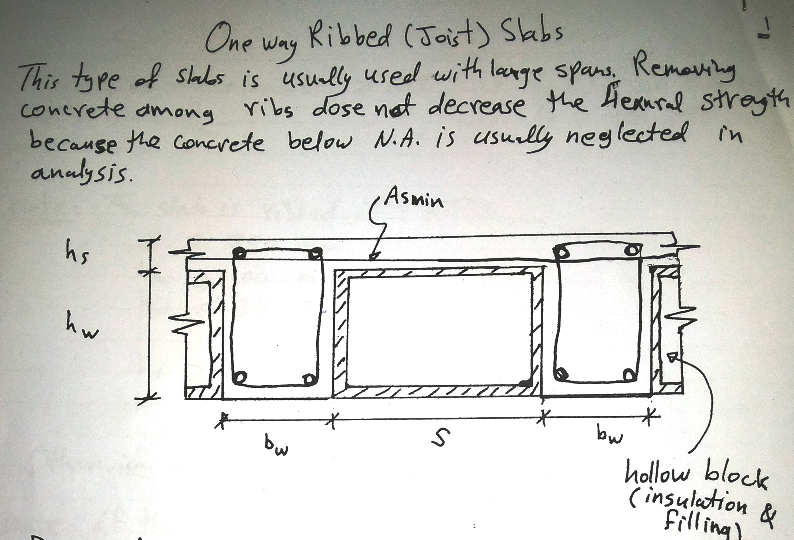

Slide 7
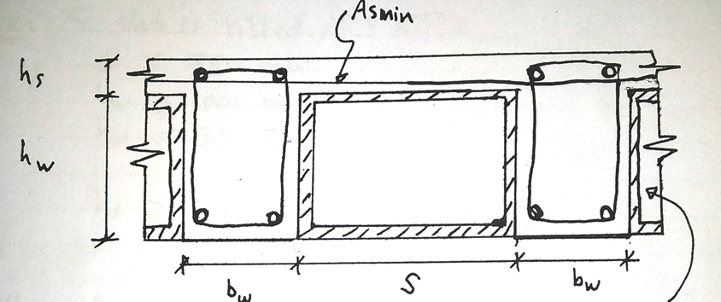

Slide 8
